Slide 1
DOA estimation based on SDR and implementation of passive radar system
张镇涛11813106
邱逸鹏11712514
2021/5/26

Slide 2
Outline
1. Task
2. KerberosSDR Realization
3. Pynq Realization
4. Music Algorithm
5. Conclusion

Slide 3
Task
Use PYNQ platform and KerberosSDR to realize a DOA estimation system. The key point is on the realization of the MUSIC algorithm on PYNQ.
Group division:
KerberosSDR: 11813106 张镇涛
PYNQ: 11712514 邱逸鹏
MUSIC algorithm: 张镇涛+邱逸鹏

Slide 4
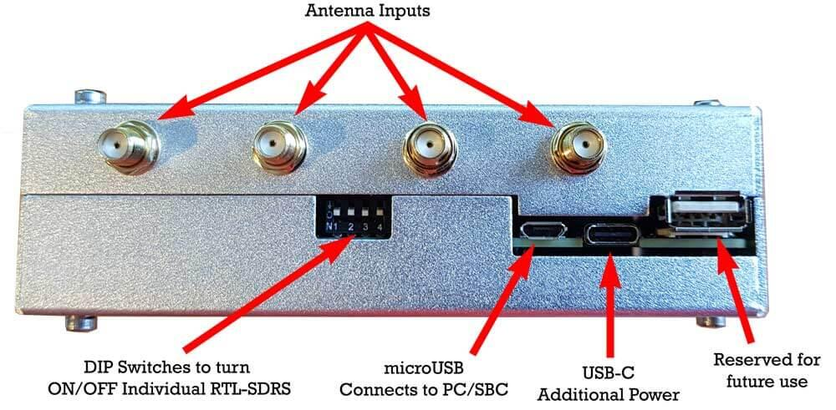
KerberosSDR Realization
Fig. 1. KerberosSDR Labelled Ports

Slide 5
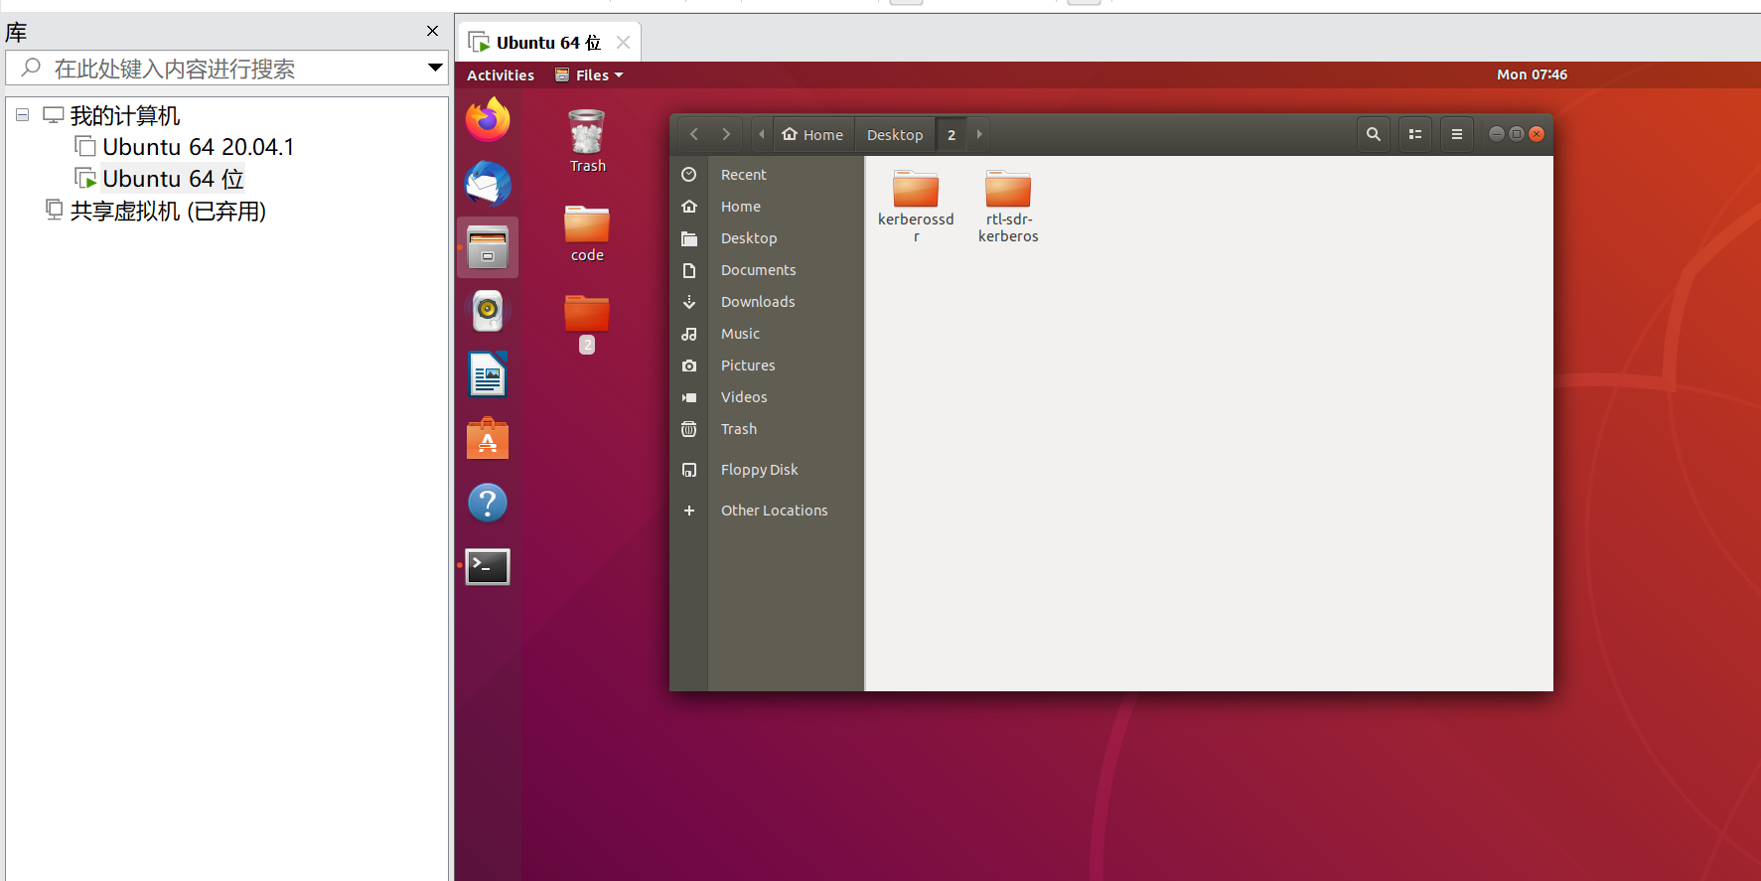
KerberosSDR Realization
Fig. 2. The installed driver software and its code storage files

Slide 6
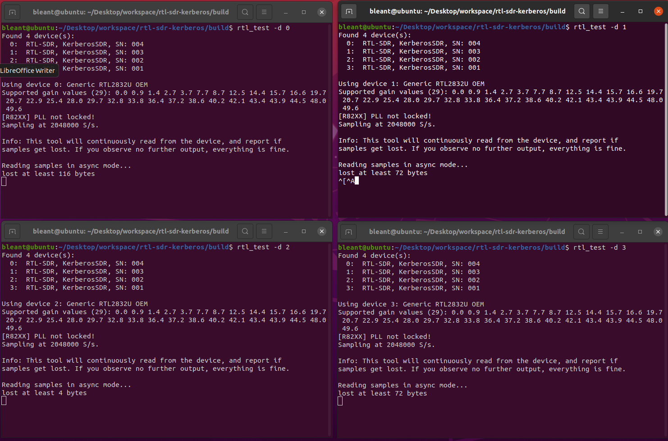
KerberosSDR Realization
Fig. 3. Detected four-channel rtl-sdr channel data

Slide 7
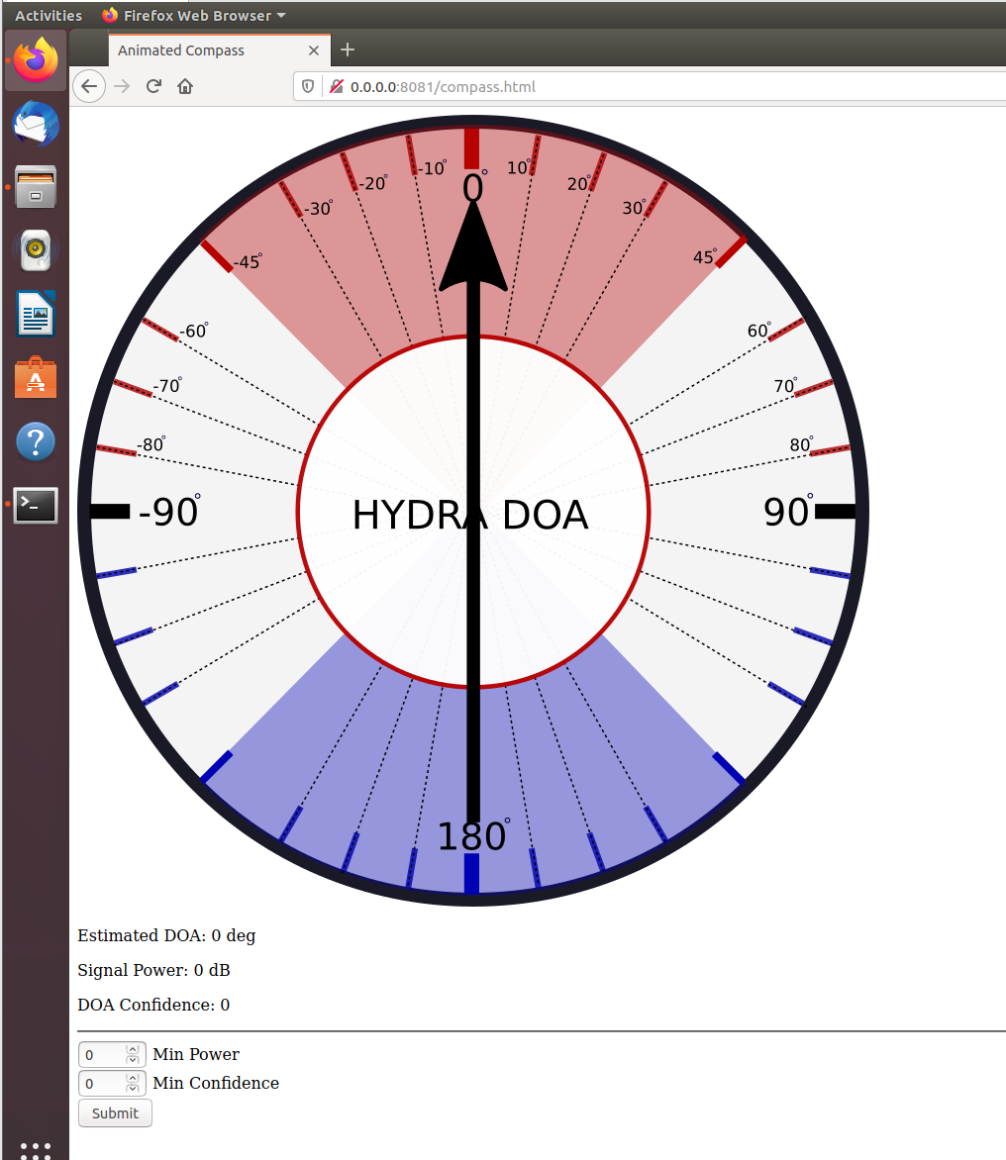
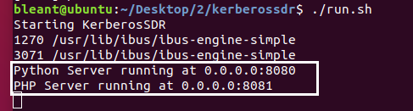
KerberosSDR Realization
Fig. 4. Run the program

Slide 8
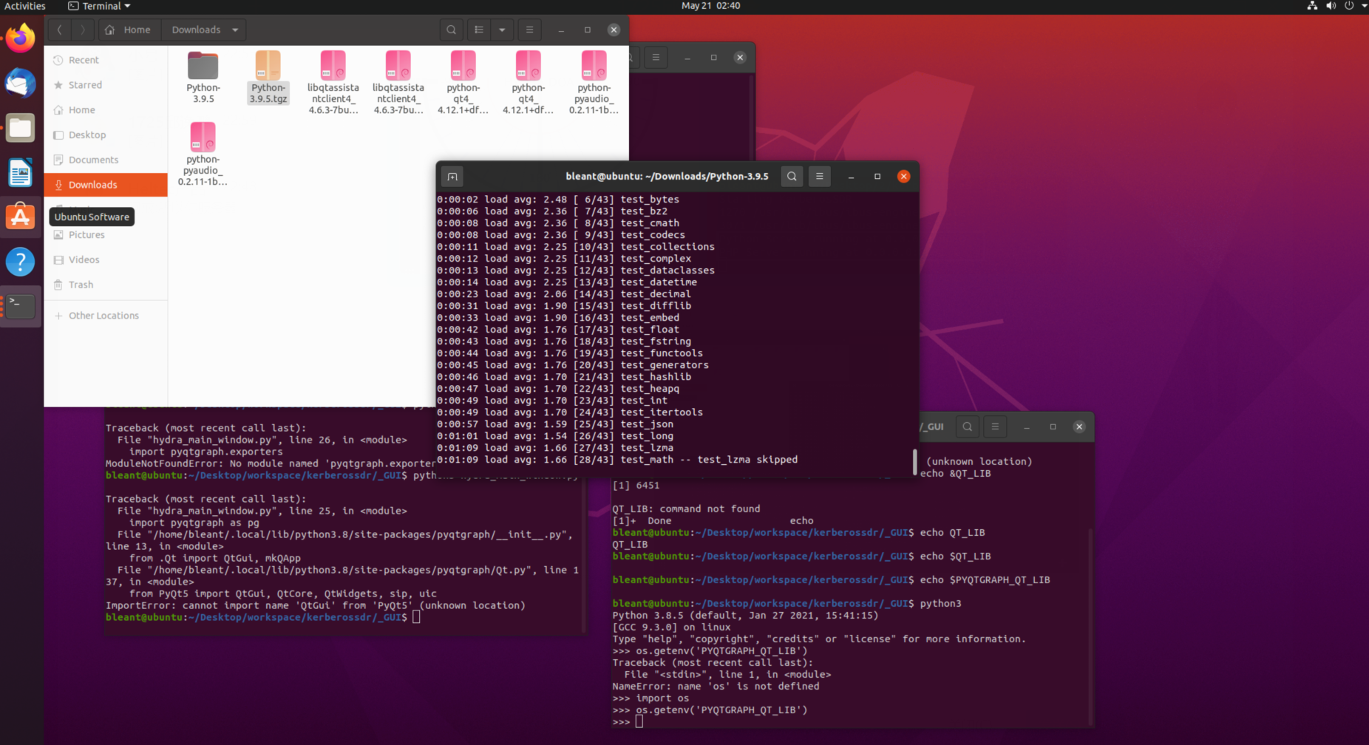
KerberosSDR Realization
Fig. 5. Suffer a problem

Slide 9
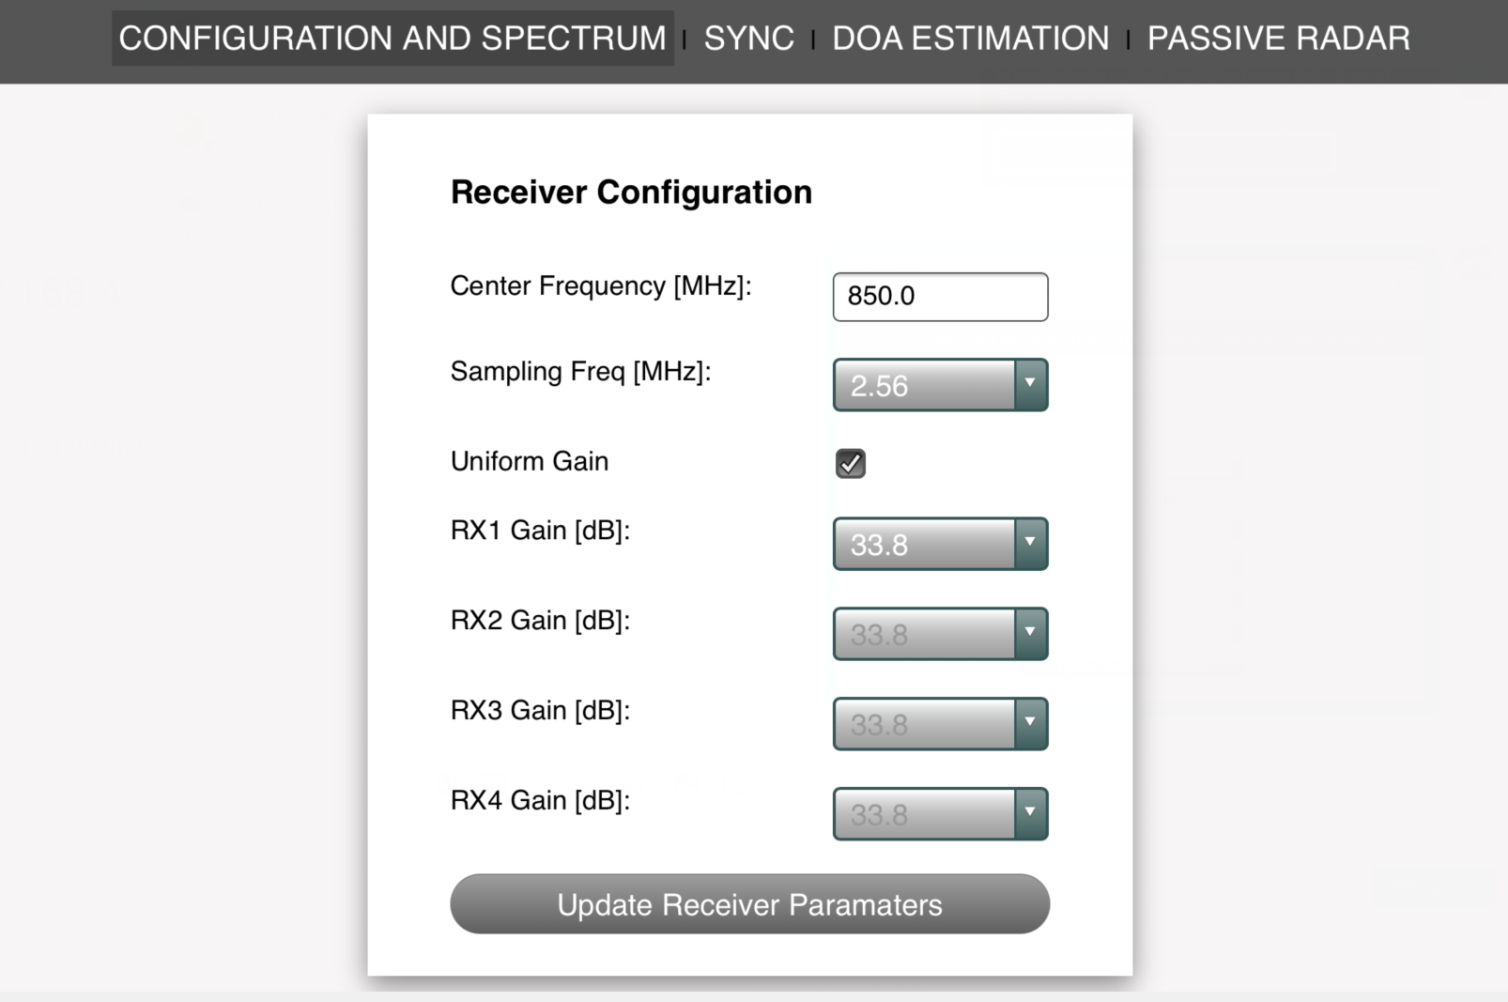
KerberosSDR Realization
Fig. 6. Connect to WiFi, enter 192.168.4.1:8080/init

Slide 10
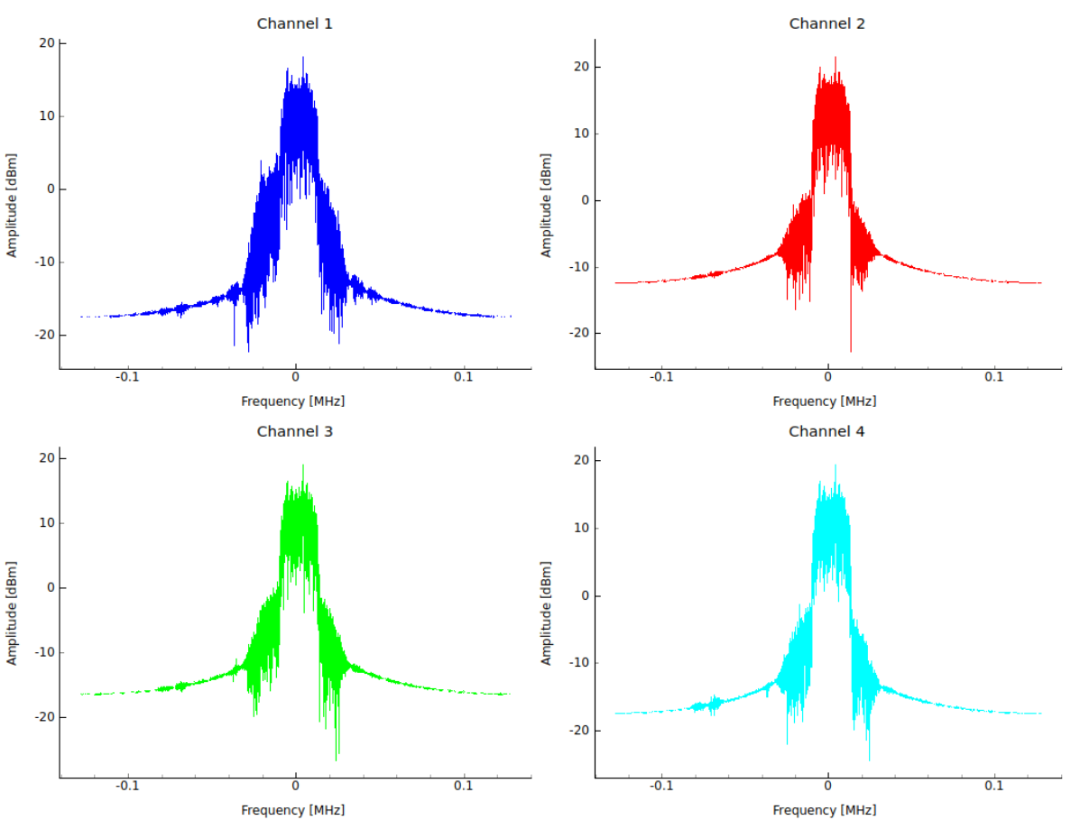
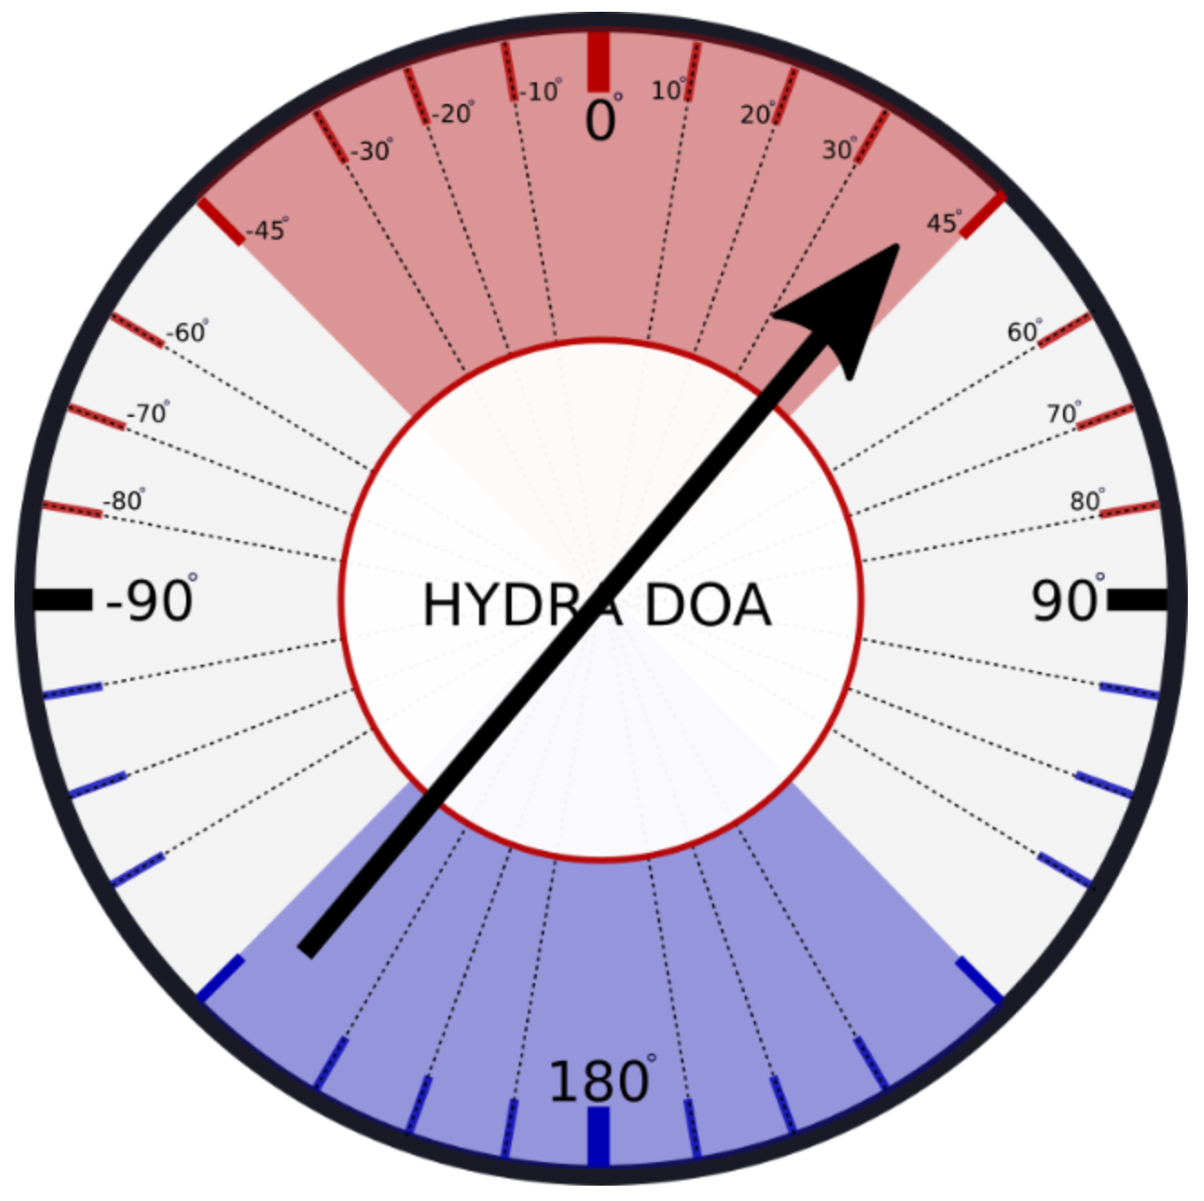
KerberosSDR Realization
Fig. 8. Interface showing the direction of arrival
Fig. 7. Four rtl-sdr received power spectra

Slide 11
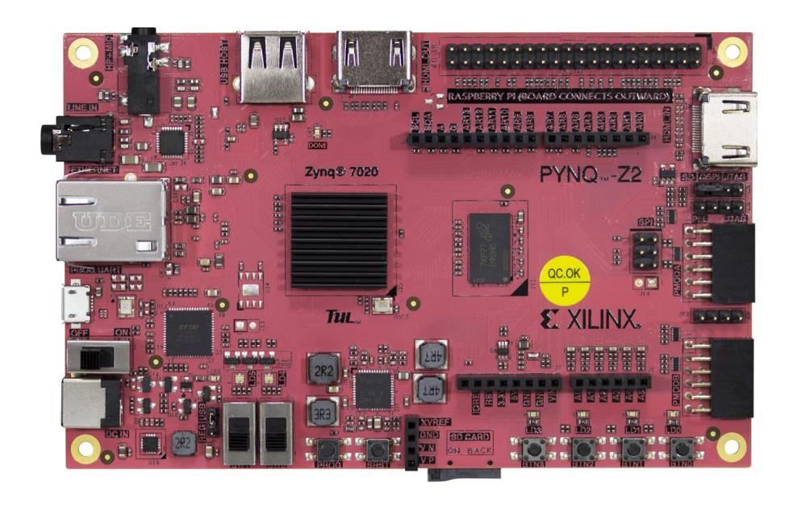
Pynq Realization
Fig. 9. Pynq-z2

Slide 12
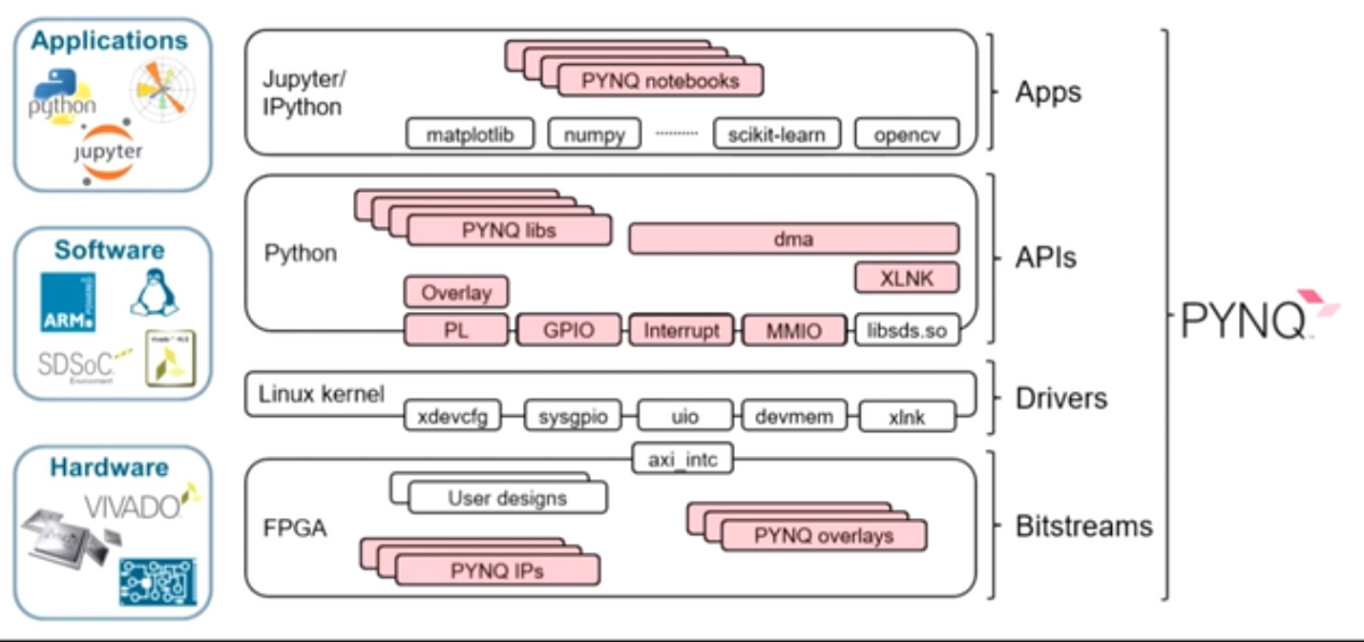
Pynq Realization
Fig. 10. Python on ZYNQ

Slide 13
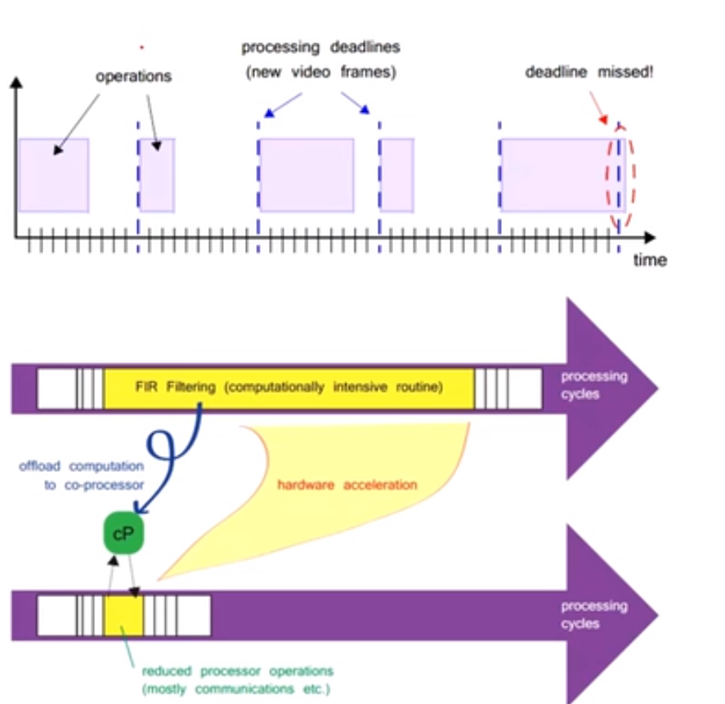
Pynq Realization
Fig. 11. Zynq Advantage - Use FPGA for acceleration

Slide 14
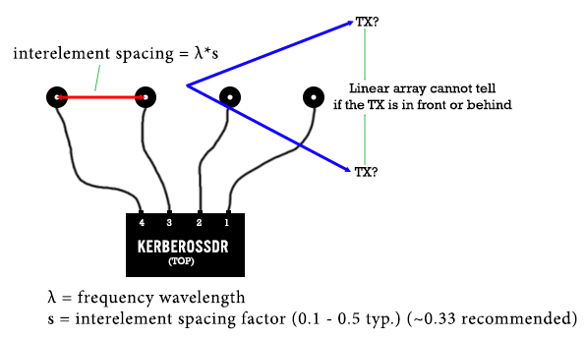
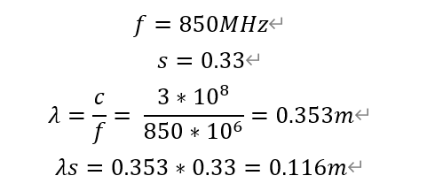
Direction Finding Antenna Array
Fig. 12. ULA (uniform linear array) antenna arrangement method

Slide 15
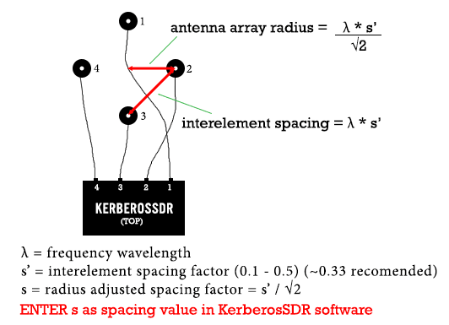
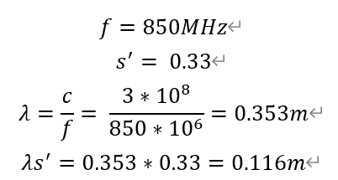
Direction Finding Antenna Array
Fig. 13. UCA (uniform circular array) antenna arrangement method

Slide 16
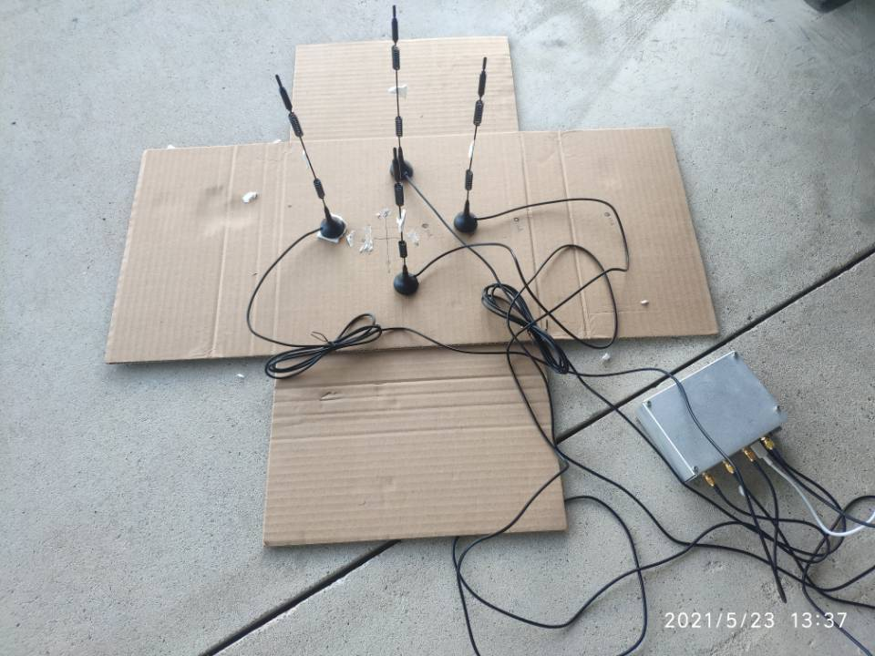
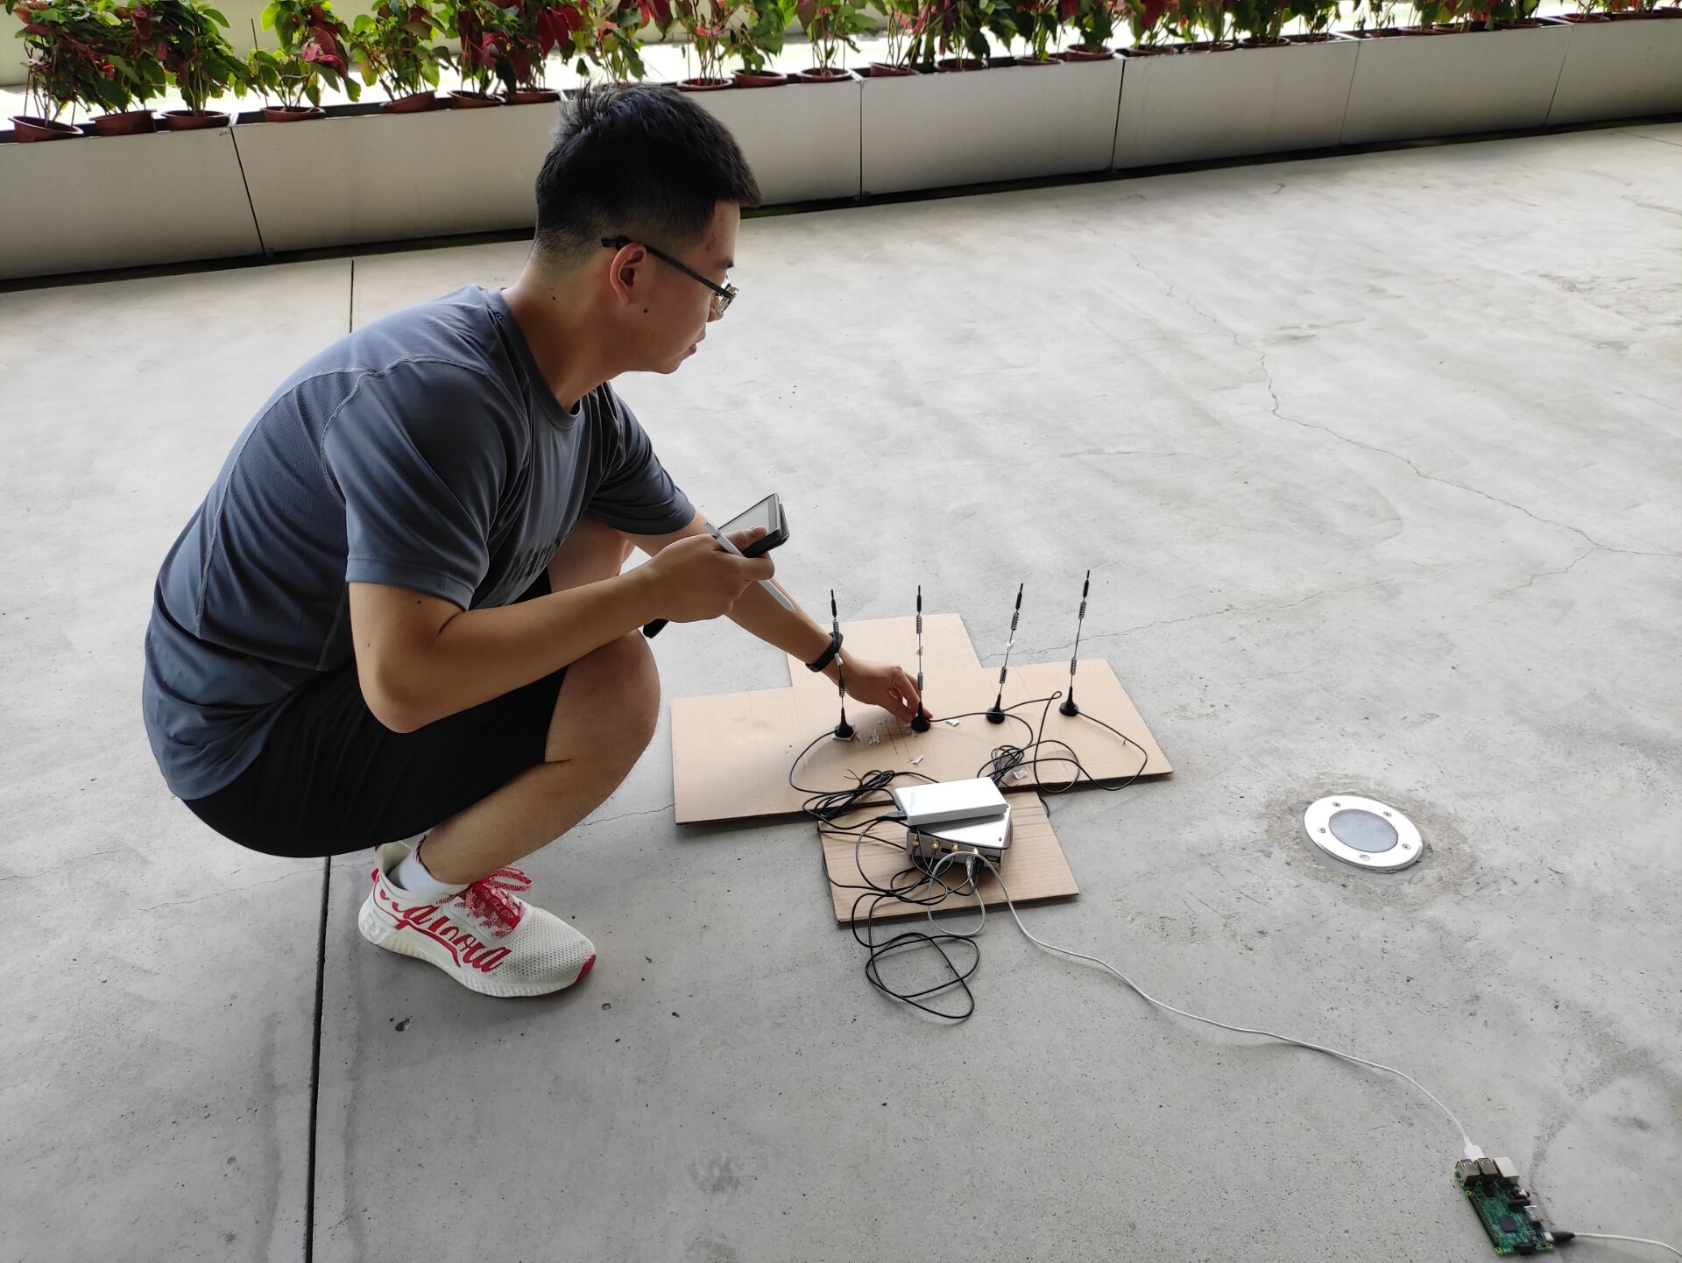
Direction Finding Antenna Array
Fig. 13. Construction of antenna array

Slide 17
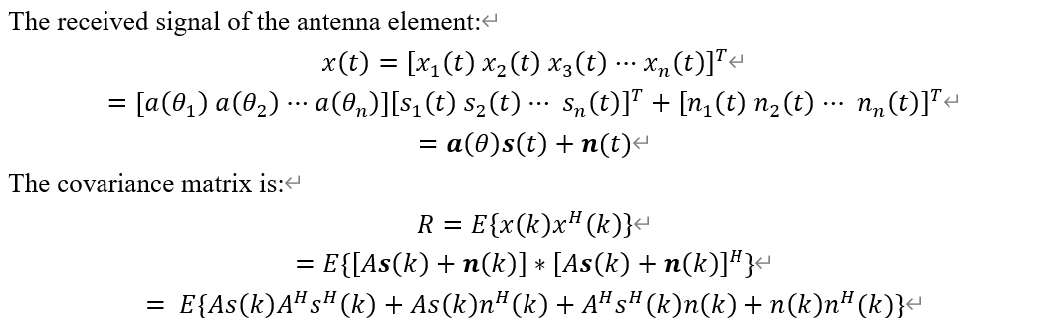
Music Algorithm (ULA)

Slide 18
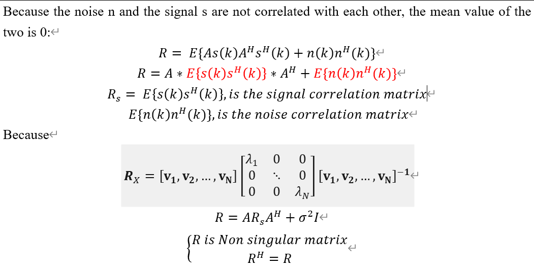
Music Algorithm (ULA)

Slide 19
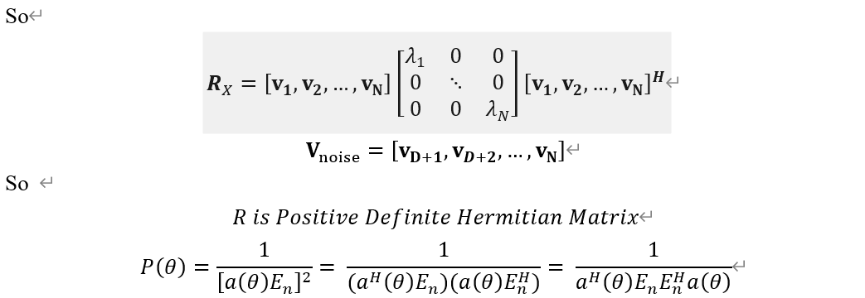
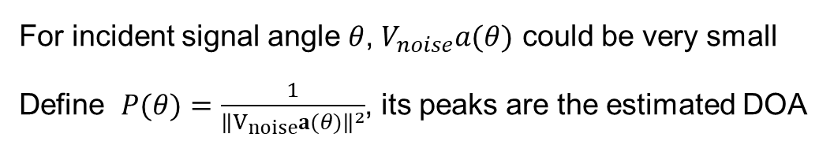
Music Algorithm (ULA)
For incident signal angle $θ$, $V_{noise}a(θ)$ could be very small
Define $P(θ)=\frac{1}{{\left\|V_{noise}a(θ)\right\|}^{2}}$, its peaks are the estimated DOA

Slide 20
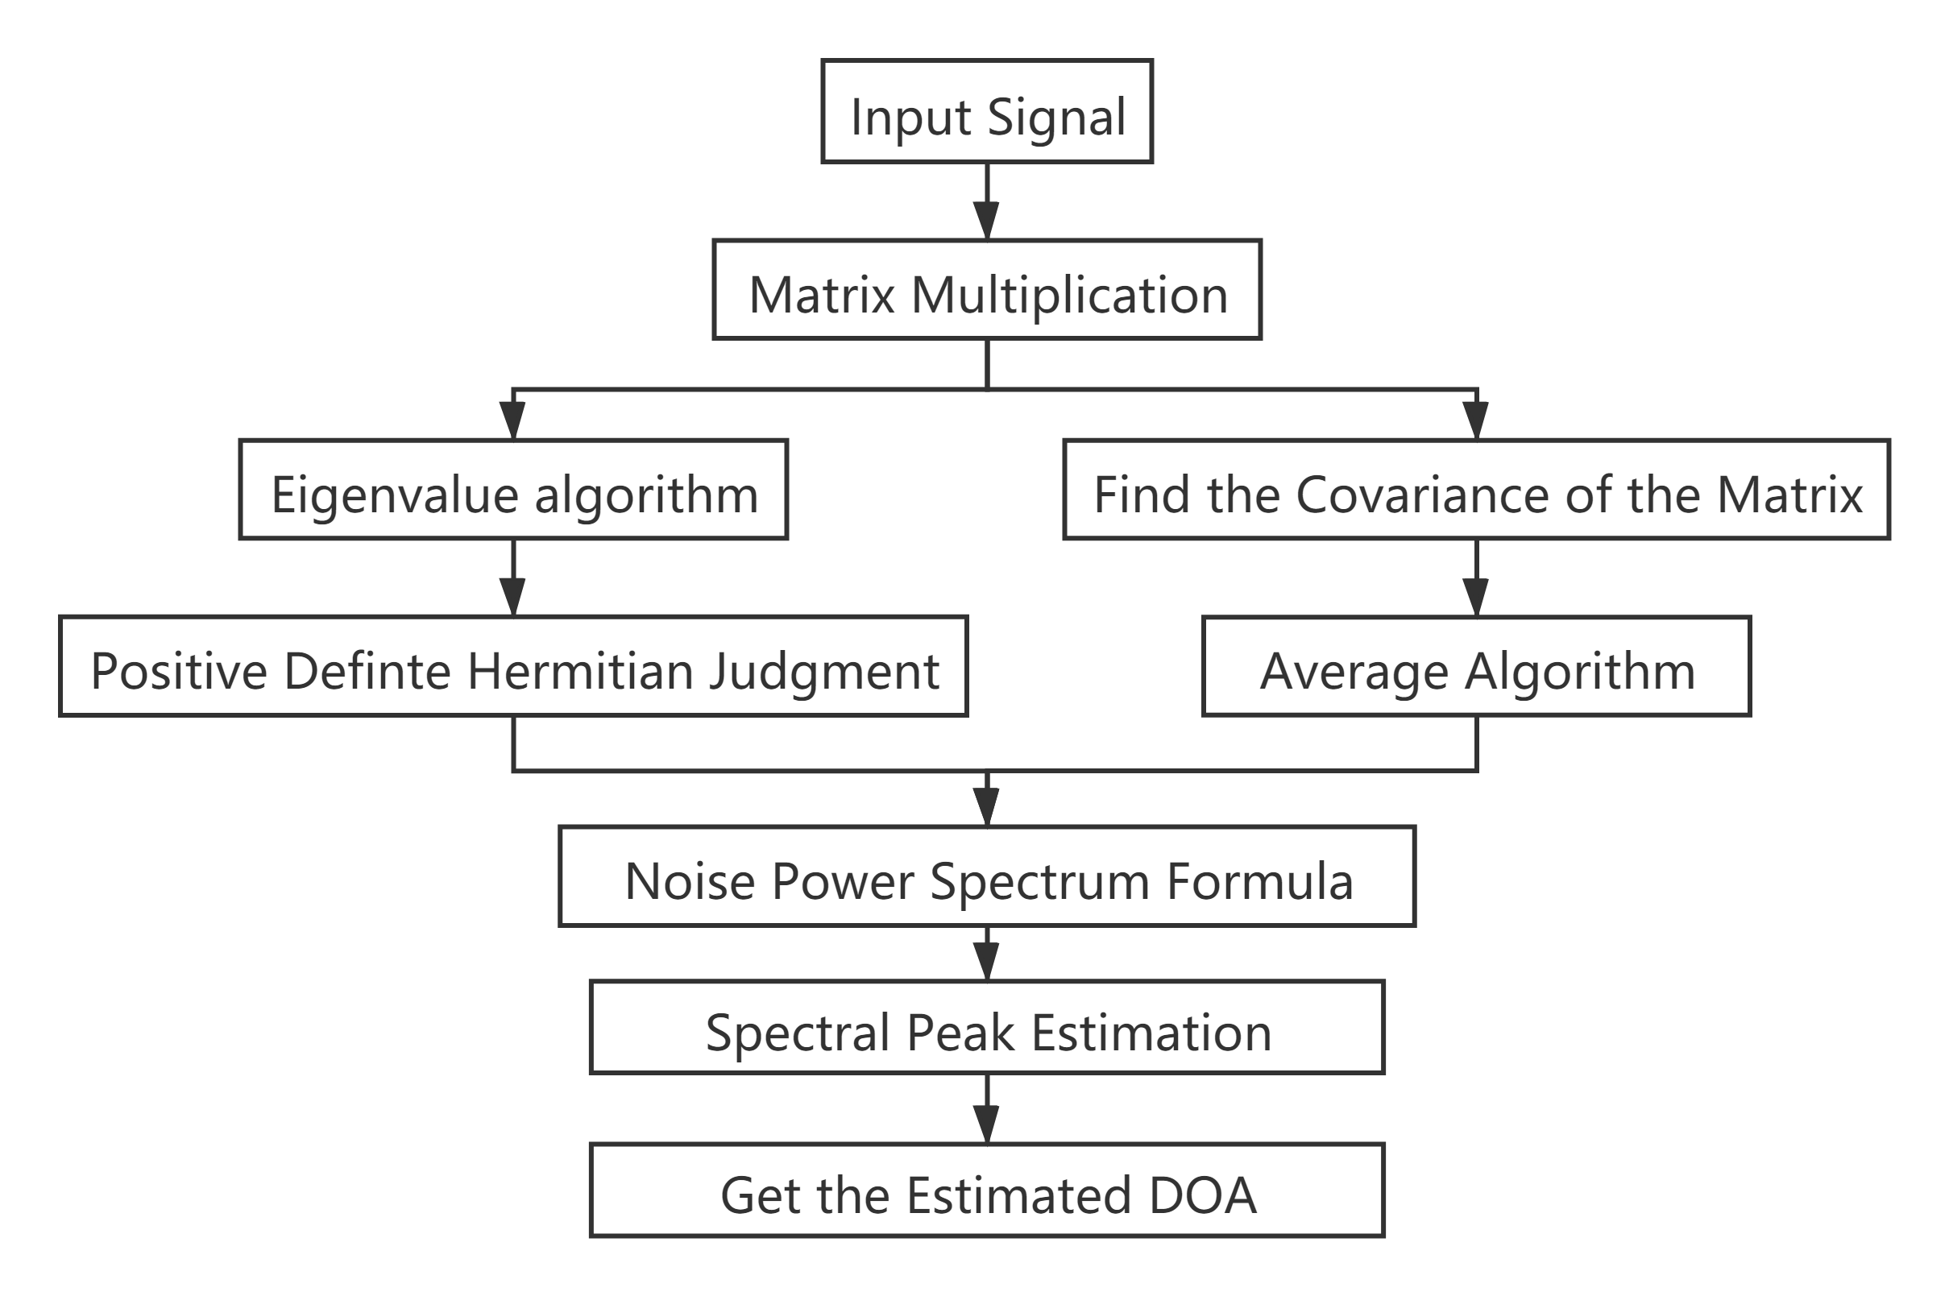
Music Algorithm (ULA)

Slide 21
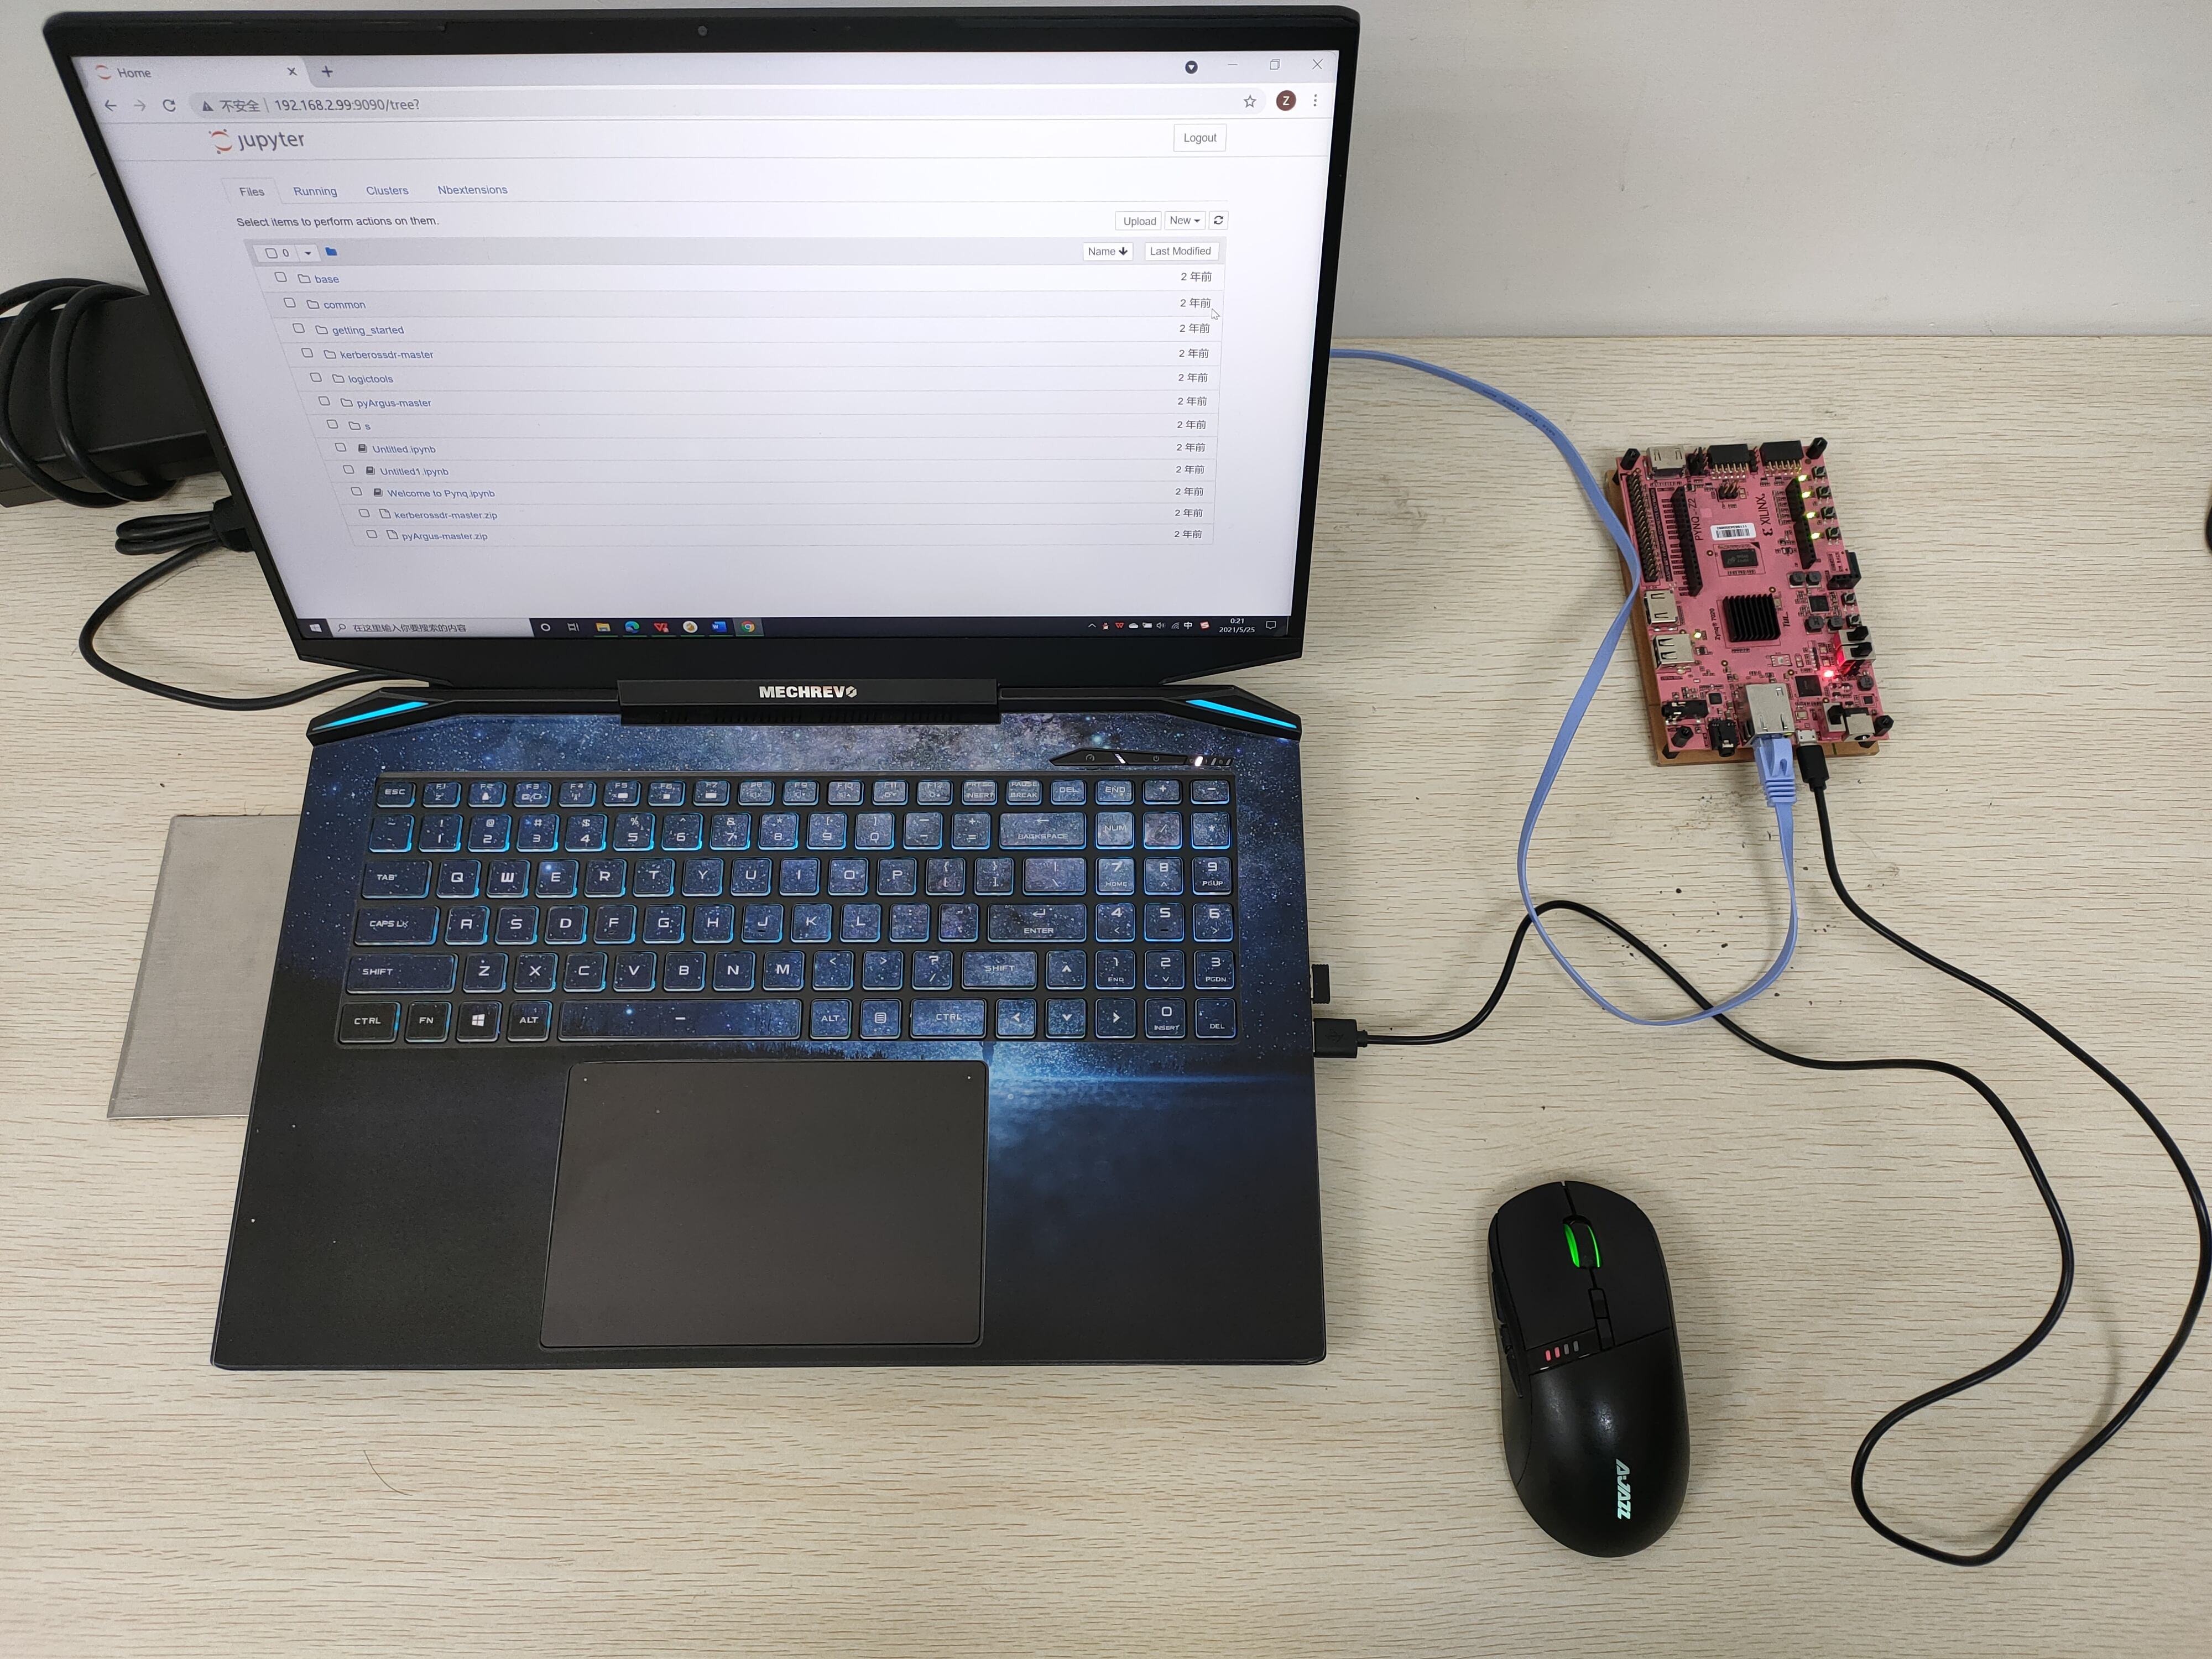
Music Algorithm
Fig. 14. PYNQ on PC

Slide 22

Music Algorithm
Fig. 15. Realization of Music Algorithm

Slide 23
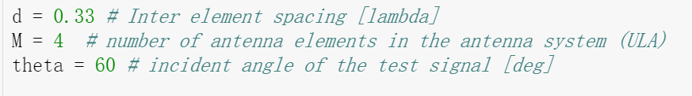
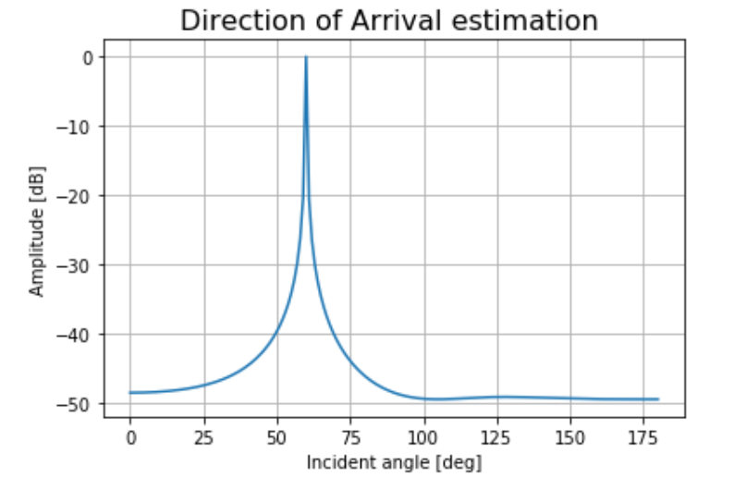
Result
Fig. 18. Result (60 degree)

Slide 24
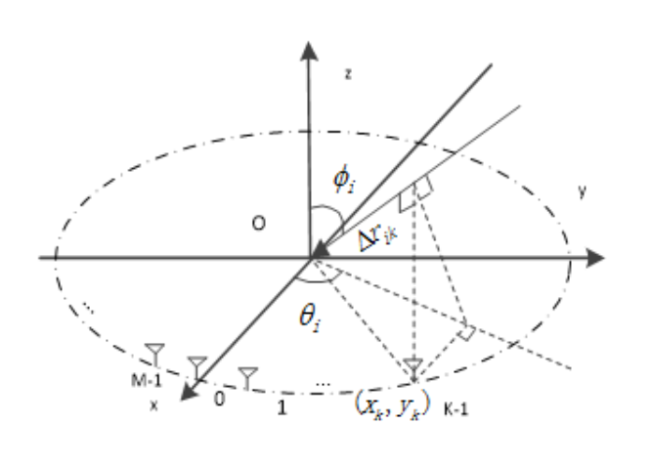
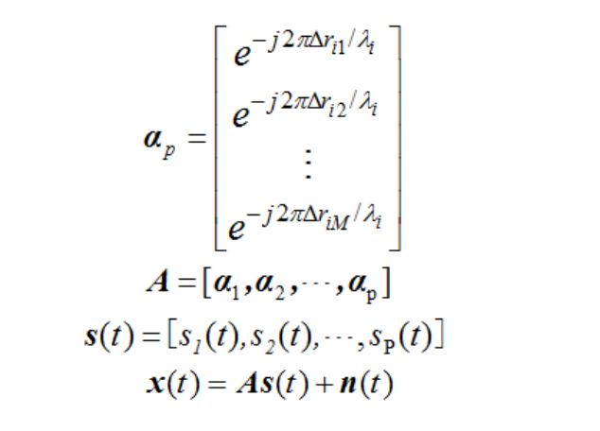
Need to Continue...
Fig. 19. Figure of UCA
Fig. 20. UCA scanning vector

Slide 25
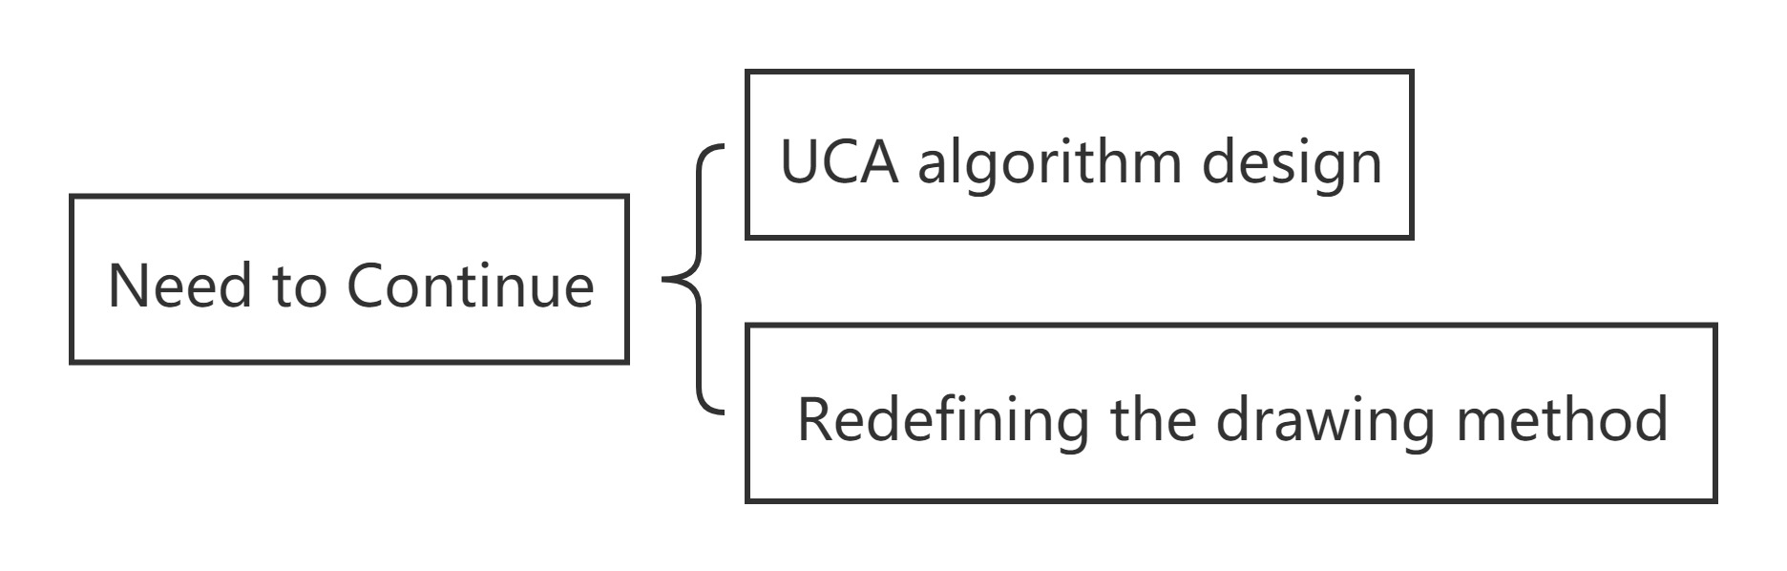
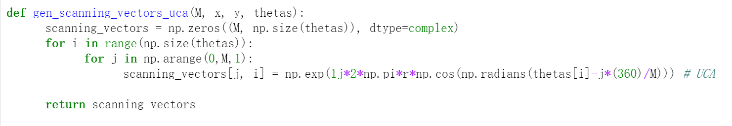
Need to Continue...
Fig. 19. Realization of UCA

Slide 26
Conclusion
The essence of the MUSIC algorithm is to divide the received data into two orthogonal subspaces through the mathematical decomposition of the array received data: one is the signal subspace consistent with the array manifold of the signal source, and the other is the signal subspace. Intersecting noise subspaces. The subspace decomposition method is to use the orthogonal characteristics of the two subspaces to construct a "needle-shaped" spatial spectrum peak, thereby greatly improving the resolution of the algorithm.

Slide 27



Thank You！

